Slide 1
UNIT III SYNTACTIC ANALYSIS

Slide 2
What is Syntactic Analysis?
Parsing is analyzing sentence structure.
Checks grammatical correctness.
Produces a parse tree based on grammar.
Essential for many NLP tasks.

Slide 3
Goals of Syntactic Analysis
Identify syntactic structure.
Support semantic interpretation.
Enable applications like machine translation, QA systems, chatbots.
Provide a basis for higher-level analysis.

Slide 4
What is a Grammar?
A formal set of rules that defines valid sentence structures.
Consists of syntax rules for forming phrases.
NLP uses formal grammars like CFGs.

Slide 5
What is a Context-Free Grammar (CFG)?
A context-free grammar (CFG) is a formal grammar used to generate all possible strings in a given formal language.
CFGs are widely used in computer science and linguistics to describe the syntax of programming languages and natural languages.
The "context-free" part means that the rules for rewriting a non-terminal symbol don't depend on the symbols surrounding it.

Slide 6
Components of CFG
A CFG is a 4-tuple (V, Σ, R, S):
Non-terminals (V): S, NP, VP, etc.
Terminals (Σ): actual words like 'dog', 'chased'
Start symbol (S): usually S
Production Rules (R):
S → NP VP
NP → Det N
VP → V NP

Slide 7
Example CFG Rules
For example, a simple CFG for a subset of English might include rules like:
S → NP VP (A sentence is a noun phrase followed by a verb phrase)
NP → Det N (A noun phrase is a determiner followed by a noun)
VP → V NP (A verb phrase is a verb followed by a noun phrase)
And lexical rules like:
Det → 'a' | 'the'
N → 'dog' | 'cat'
V → 'chased' | 'saw'

Slide 8
Sentence Derivation – "the dog chased a cat"
S → NP VP
→ Det N VP
→ the N VP
→ the dog VP
→ the dog V NP
→ the dog chased Det N
→ the dog chased a cat

Slide 9
Parse Tree (text-based drawing)
S
/ \
NP VP
/ \ / \
Det N V NP
| | | / \
the dog chased a cat

Slide 10
Grammar Rules for English
The grammar rules for English, particularly in the context of computational linguistics, are an extensive set of production rules used to describe the syntactic structure of sentences.
Grammar defines the structure of a language.
In NLP, grammar helps in understanding sentence structure.
Includes rules for word order, agreement, and syntax.

Slide 11
Types of Grammar Rules
Syntax Rules: Sentence structure.
Morphological Rules: Word formation
Agreement Rules: Subject-verb agreement, etc.
Phrase Structure Rules: How phrases are formed.

Slide 12
Phrase Structure Rules
Rules that define sentence formation using phrases.
Example: S → NP VP
NP → Det N | Det Adj N
VP → V NP | V NP PP
PP → P NP A Prepositional Phrase consists of a Preposition followed by a Noun Phrase.

Slide 13
Example Sentence Parsing
Sentence: 'The big dog chased the cat.'
S → NP VP
NP → Det Adj N → The big dog
VP → V NP → chased NP
NP → Det N → the cat

Slide 14
Subject-Verb Agreement
Subjects and verbs must agree in number.
Correct: 'She walks.'
Incorrect: 'She walk.'
Important for syntactic correctness.

Slide 15
Tense and Aspect Rules
Tense: Past, Present, Future.
Aspect: Simple, Perfect, Progressive.
Helps in understanding verb usage.
Examples: 'He is eating', 'He has eaten', 'He ate'

Slide 16
Word Order in English
Standard word order: Subject-Verb-Object (SVO).
Example: 'John eats an apple.'
Modifiers typically follow the word they modify.

Slide 17
Parse Trees
Parse trees visually represent how a sentence is derived using CFG rules.
They show hierarchical structure from S to terminals.

Slide 18
Leftmost and Rightmost Derivations
Leftmost: expand the leftmost non-terminal first.
Rightmost: expand the rightmost non-terminal first.
Both result in the same final sentence but different derivation paths.

Slide 19
Example Derivation
Sentence: 'The dog chased the cat'
Rules:
S → NP VP
NP → Det N
VP → V NP
Derivation (Leftmost):
S → NP VP → Det N VP → Det N V NP → ...

Slide 20
Bracket Notation for Trees
Another way to represent parse trees:
[S [NP [Det The] [N dog]] [VP [V chased] [NP [Det the] [N cat]]]]

Slide 21
Why Parse Trees Matter
They help in semantic interpretation, identifying syntactic roles (subject, object), and guiding downstream NLP tasks.

Slide 22
Treebanks in NLP
A treebank is a large, annotated corpus of text where each sentence is paired with its syntactic analysis, typically in the form of a parse tree.
Think of it as a collection of sentences that have already been parsed by human linguists, providing a "gold standard" for what a correct parse should look like.
Most common format: constituency-based parse trees (e.g., Penn Treebank).

Slide 23
Treebank Example
Sentence: 'The cat sleeps'
Annotated tree: [S [NP [Det The] [N cat]] [VP [V sleeps]]]

Slide 24
Parse Tree Example from Treebank
S
NP
VP
Det
N
V
The
cat
sleeps

Slide 25
Introduction to Normal Forms
In Context-Free Grammar (CFG), the production rules can be written in different ways. Sometimes, they may be complicated and not suitable for parsing algorithms (like CYK parsing).
To simplify, grammars can be converted into normal forms, where production rules follow strict structural patterns.
The two most common normal forms are Chomsky Normal Form (CNF) and Greibach Normal Form (GNF).

Slide 26
Why Use Normal Forms?
To simplify parsing and transformation.
Enable use of standard parsing techniques.
Ensure consistency and clarity in grammar.

Slide 27
Chomsky Normal Form (CNF)
A CFG is said to be in Chomsky Normal Form if every production rule is of one of the following forms:
Binary form:
A→BC
Where A,B,C are non-terminal symbols.
B and C cannot be the start symbol.

Slide 28
2. Terminal form:
A→ a
Where A is a non-terminal and a is a terminal symbol.
3. Special case (optional)
S→ϵ, only if the grammar generates the empty string.
This is allowed only if S is the start symbol.
Note: No rule in CNF can have:
More than two non-terminals on the right-hand side.
A mix of terminals and non-terminals together.
Empty productions (except start symbol).
Unit productions (like A→B)

Slide 29
Steps to Convert CFG to CN
Step 1: Remove null (ε) productions
If you have rules like A→ϵ remove them (unless A is start symbol).
Step 2: Remove unit productions
Rules like A→B Replace them with A→α where B→α
Step 3: Remove useless symbols
Non-terminals that do not derive terminals or cannot be reached from the start symbol.
Step 4: Convert remaining productions
If a production has more than 2 symbols on RHS, break them into binary rules.
If a production mixes terminals and non-terminals, introduce new variables for terminals.

Slide 30
Example: CNF Conversion
Original: S → ASA | aB,
A → B | S,
B → b
Step-by-step transformation:
Remove unit productions and simplify.
Final CNF: S → AX | aB,
X → SA,
A → b | aB,
B → b

Slide 31
What is Dependency Grammar?
A grammar based on binary head–dependent relationships.
Each word (except the root) depends on another word.
Represents structure using directed links (arcs).
Words are connected by dependency arcs.
Example:
Sentence: "She eats apples"
Head: "eats"
Dependents: "she" (subject), "apples" (object)

Slide 32
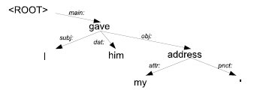
Fig. shows a sample dependency grammar parse, using the dependency formalism

Slide 33
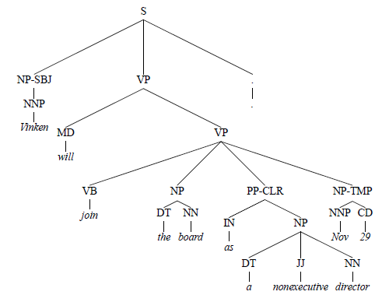
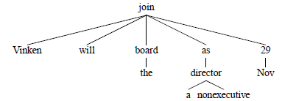
A phrase structure tree from the Wall Street Journal component of the Penn Treebank
The dependency tree produced

Slide 34
Benefits of Dependency Grammar
Close mapping to semantic roles (who did what to whom).
Effective for free word order languages like Hindi, Russian.
More compact and simpler than phrase structure trees.

Slide 35
What is Syntactic Parsing in NLP?
Syntactic parsing is the process of assigning a structural description (a parse tree) to a sentence according to a grammar.
Parsing in Natural Language Processing (NLP) is the process of analyzing the grammatical structure of a sentence.
It identifies the syntactic roles of words and how they relate to each other to form valid structures according to a grammar.

Slide 36
Types of Parsing
Constituency Parsing (Phrase Structure Parsing)
Breaks a sentence into sub-phrases (constituents)
Based on Context-Free Grammars (CFGs)
Example: Sentence: "The dog barked“
Parse Tree
S (Sentence) / \ NP VP / \ \
Det N V | | | The dog barked

Slide 37
Dependency Parsing
Focuses on head-dependent relations between words
Each word (except the root) depends on another
Example:
"barked" is the main verb (head)
"dog" is the subject (depends on "barked")

Slide 38
Types of ambiguity
Lexical ambiguity (word sense / POS): a word has multiple possible senses or POS tags. Example: “bank” → financial institution vs river bank. Or “duck” → noun (bird) vs verb (lower head).
Syntactic (structural) ambiguity — same sequence of words, multiple valid tree
Prepositional-phrase (PP) attachment / modifier attachment: “I saw the man with a telescope.” Two readings:
I [saw [the man with a telescope]] — the man has the telescope.
[I with a telescope] saw the man (or better: I used a telescope to see the man) — the instrument attaches to the verb saw

Slide 39
Coordination ambiguity
“old men and women”
(old men) and (women) → only men are old.
old (men and women) → both men and women are old.
D. Gerund / VP vs NP ambiguity:
“Visiting relatives can be annoying.”
Visiting relatives (the act) is annoying.
Relatives who are visiting can annoy you.
E. Quantifier / scope ambiguity (semantic)
“Every student loves a teacher.”
For every student there exists a (possibly different) teacher they love.
There exists one teacher loved by every student.

Slide 40
Dynamic Programming Parsing
Avoids redundant computations during parsing.
Uses memoization to store intermediate results.
Examples: CYK Parser, Earley Parser.
Efficient for large-scale grammar parsing.

Slide 41
CYK Algorithm Introduction
CYK (Cocke–Younger–Kasami) is a bottom-up parsing algorithm for CNF grammars.
It fills a triangular table to build up parses.
Works with CFGs in Chomsky Normal Form (CNF).
Bottom-up parsing using dynamic programming table.
Checks if a string belongs to a language.
Used in compilers and NLP syntactic analysis

Slide 42
CYK ALGORITHM
CYK algorithm is a parsing algorithm for context free grammar.
In order to apply CYK algorithm to a grammar, it must be in Chomsky Normal Form. It uses a dynamic programming algorithm to tell whether a string is in the language of a grammar.

Slide 43
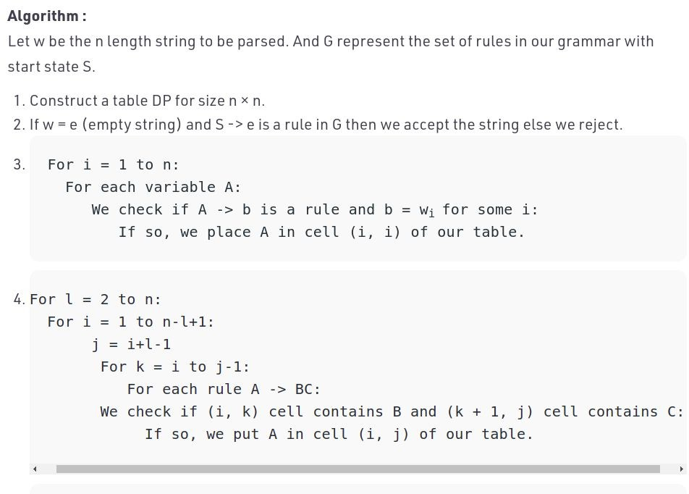

Slide 44
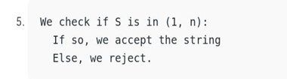

Slide 45
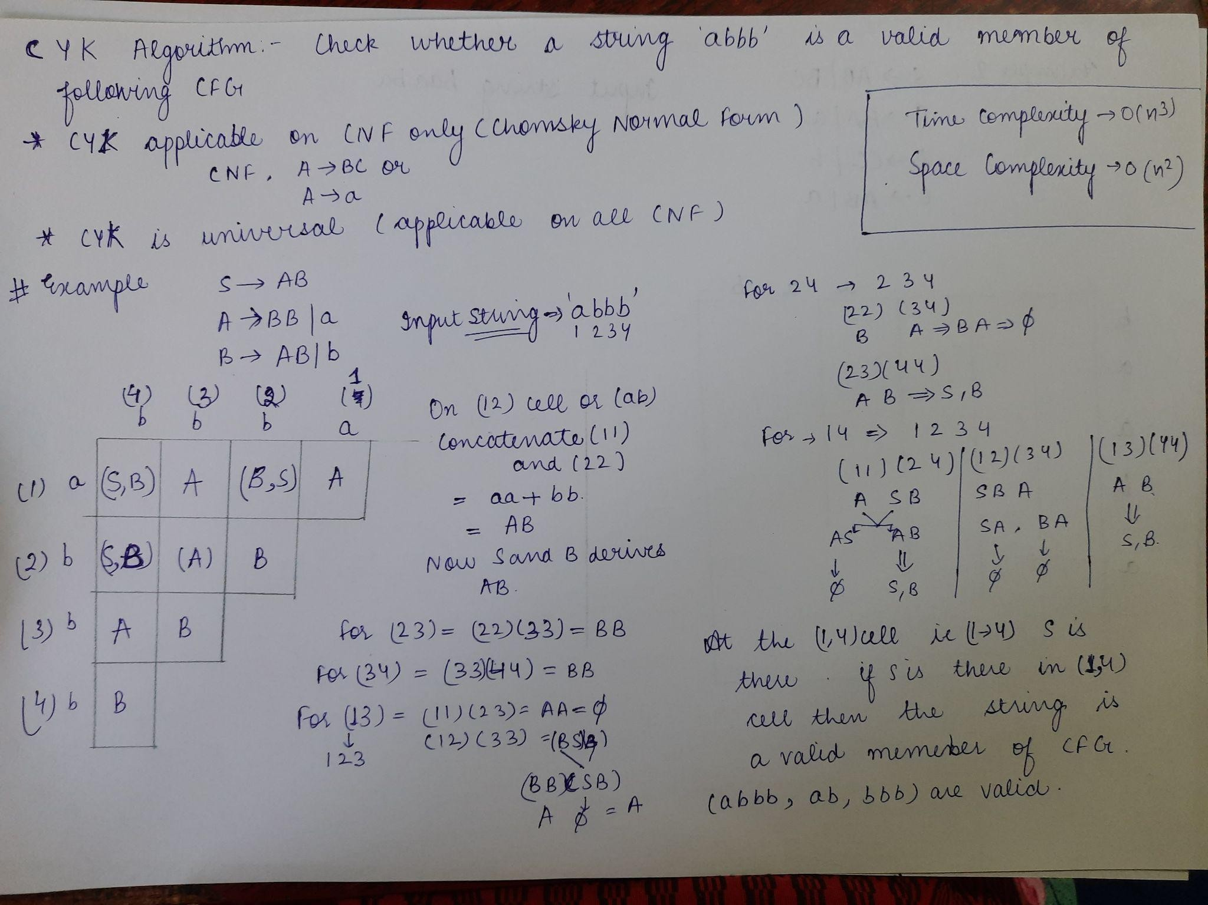

Slide 46
Input_string=”abbb”
S->AB,A->BB|a, B->AB |b
 | b (4) | b (3) | b (2) | a (1)
a (1) | {B,S} | {A} | {S,B} | {A}
b (2) | {B,S} | {A} | {B}
b (3) | {A} | {B}
b (4) | {B}

Slide 47
“baaba”
S->AB|BC , A->BA|a, B->CC|b,C->AB|a
 |  | b (1) | a (2) | a(3) | b (4) | a(5)
b | (1)
a | (2)
a | (3)
b | (4)
a | (5)

Slide 48
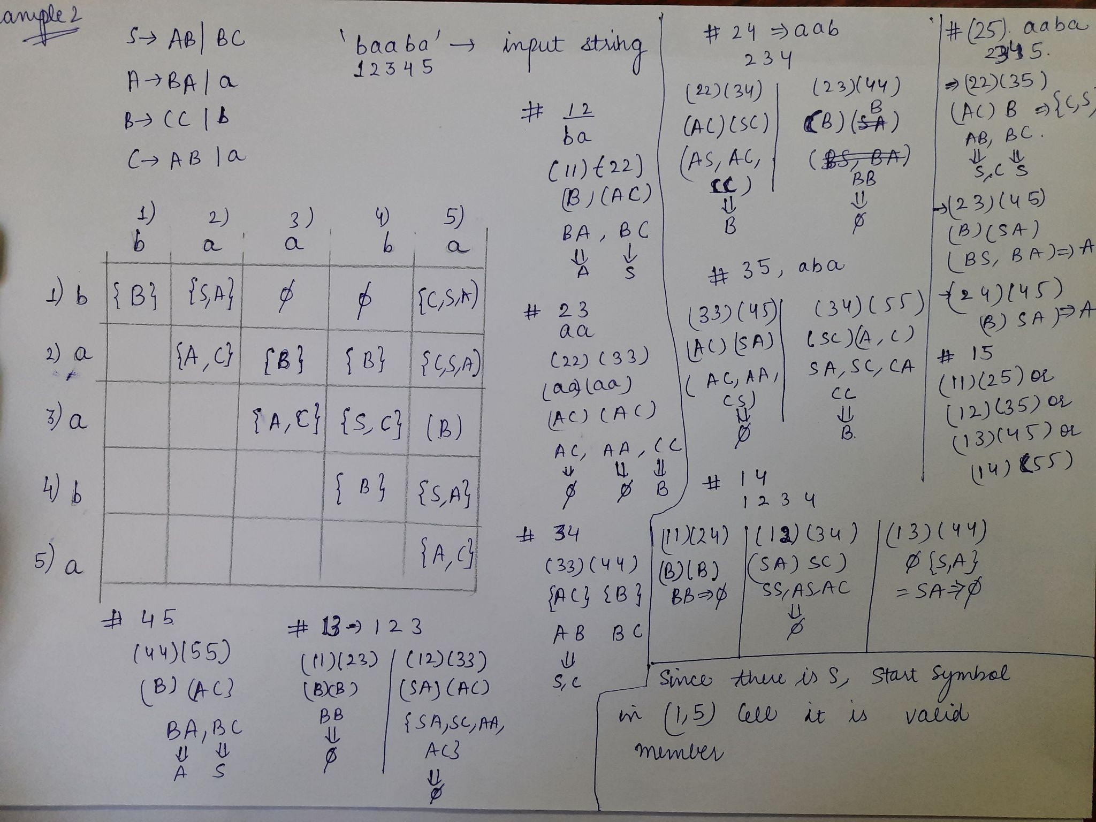

Slide 49
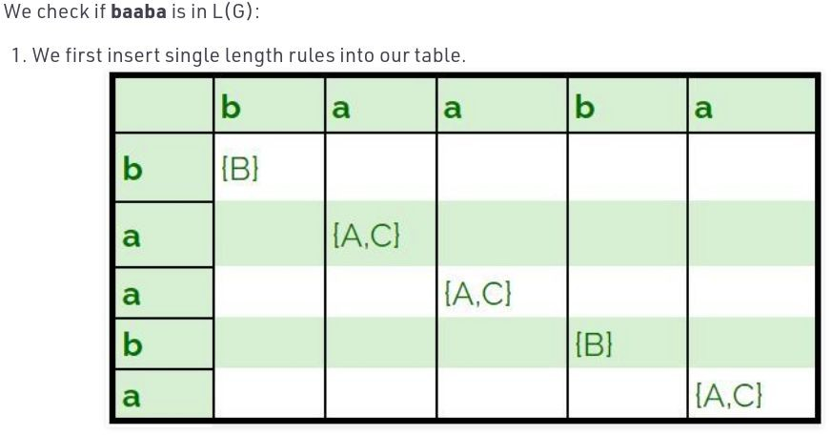

Slide 50
The Earley Parsing Algorithm
The Earley Algorithm is an efficient chart parsing algorithm used in Natural Language Processing (NLP) for parsing sentences based on Context-Free Grammars (CFGs).
Works with top-down parsing strategy
The algorithm maintains a chart (a data structure with states), one for each input position in the sentence.
A state represents a partially recognized grammar rule.

Slide 51
At each step, the algorithm applies one of three operations on the states:
Prediction
If the dot is before a non-terminal, expand it using all rules of that non-terminal.
Ex: S → • NP VP , [0]
Scanning
If the dot is before a terminal, and it matches the next input word, move the dot one step right.
Ex: NP → Det • N , [0]
Completion
If a rule is finished (dot at the end), look back to where it started and advance any rules waiting for that non-terminal.
Ex: NP → Det N • , [0]

Slide 52
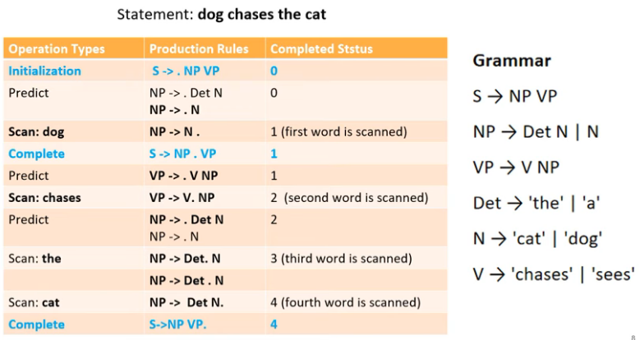
Example:

Slide 53
Earley Parsing Algorithm steps
Initialization
Create an array of charts: Chart[0..n], where each entry is a set of states.
Add the initial state to Chart[0]:
S′→∙S , [0]
For each position k= 0 to n: For each state in Chart[k], perform one of the following operations:
(a) Prediction:
If the state is of the form
A→α∙Bβ,[i],
where B is a non-terminal, then for every production B→ γ ∈ R, add the state
B→∙γ, [k]
to Chart[k]

Slide 54
(b) Scanning:
If the state is of the form
A→α∙aβ, [i]
where a∈Σ and the next input symbol is wk+1=a, then add the state
A→αa∙β, [i]
to Chart[k+1].
(c) Completion:
If the state is of the form
B→γ∙, [j]
then for each state in Chart[j] of the form
A→α∙Bβ, [i]
add the state
A→αB∙β, [i]
to Chart[k]
Acceptance Condition
If Chart[n] contains the state
S′→S∙, [0]
then accept the string; otherwise, reject

Slide 55
PARTIAL PARSING (or) SHALLOW PARSING
Many language-processing tasks simply do not require complex, complete parse trees for all inputs.
For these tasks, a partial parse, or shallow parse, of input sentences may be sufficient.
For example, information extraction systems generally do not extract all the possible information from a text; they simply identify and classify the segments in a text that are likely to contain valuable information

Slide 56
Shallow Parsing (Chunking)
What is Shallow Parsing?
Also known as chunking, it identifies syntactic constituents (e.g., noun phrases, verb phrases) without building full parse trees.
It segments sentences into shallow structures like:
NP: Noun Phrases
VP: Verb Phrases
PP: Prepositional Phrases

Slide 57
Example
Sentence:
"The morning flight from Denver has arrived“
Chunked Output:
[NP The morning flight] [PP f] [NP Denver] [VP has arrived.] rom

Slide 58
Finite-State Rule-Based Chunking:
In finite-state rule-based chunking, a set of rules is hand-crafted to capture the phrases of interest for any particular application.
In most rule-based systems, chunking proceeds from left-to-right, finding the longest matching chunk from the beginning of the sentence, it then continues with the first word after the end of the previously recognized chunk.

Slide 59
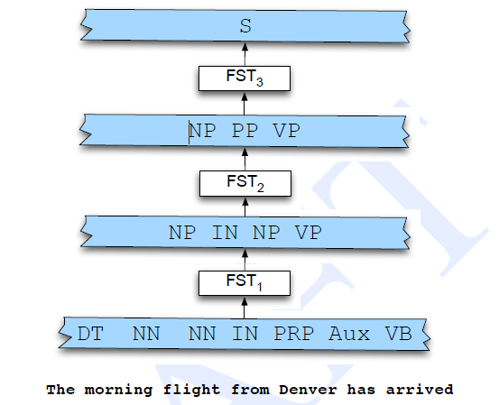
Fig. shows Chunk-based partial parsing via a set of finite-set cascades.
FST1 transduces from part-of-speech tags to base noun phrases and verb phrases.
FST2 finds prepositional phrases.
Finally, FST3 detects sentences

Slide 60
Applications
Named Entity Recognition (NER)
Question Answering
Relation Extraction

Slide 61
Probabilistic Context-Free Grammars (PCFG)
What is a PCFG?
A Probabilistic CFG augments a regular CFG with probabilities on production rules.
Rule probabilities are learned from annotated corpora like treebanks.

Slide 62
Rule Format
S → NP VP [1.0]
NP → Det N [0.5]
VP → V NP [0.7]
Det → the [0.8]
N → dog [0.6]
V → chased [0.9]

Slide 63
Parse Tree Probability
For the sentence: "The dog chased the cat" If rules used are:
S → NP VP [1.0]
NP → Det N [0.5]
VP → V NP [0.7]
Det → the [0.8]
N → dog [0.6]
V → chased [0.9]
N → cat [0.5]
Probability of this tree: 1.0 × 0.5 × 0.7 × 0.8 × 0.6 × 0.9 × 0.5 = 0.0756

Slide 64
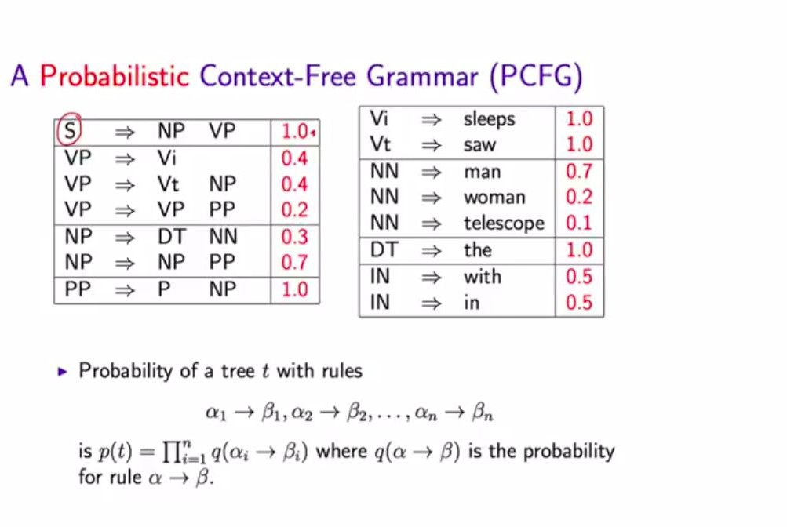

Slide 65
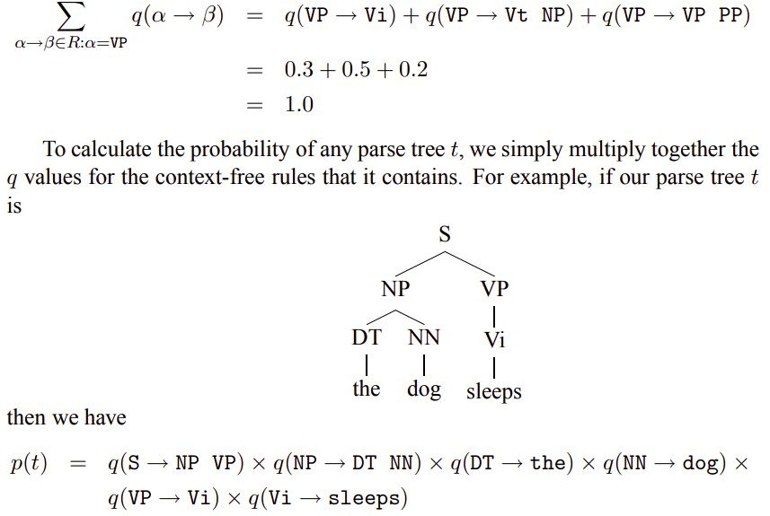

Slide 66
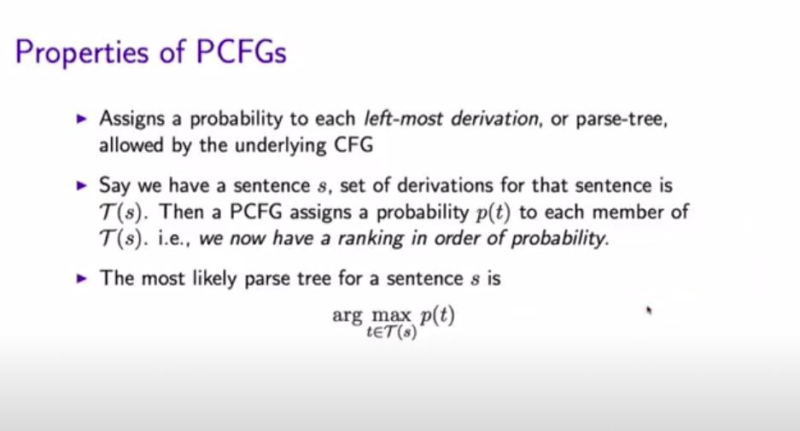

Slide 67
Why Use PCFG?
Helps resolve ambiguity by preferring more likely parses.
Crucial in speech recognition, machine translation, and syntax-based QA.

Slide 68
Probabilistic CYK Algorithm
💡 Recap: CYK
A bottom-up dynamic programming parser.
Works only with CNF (Chomsky Normal Form) grammars.
📐 Probabilistic CYK
Extends CYK to use PCFG rule probabilities.
Stores best scores in each cell instead of just possible non-terminals.

Slide 69
Input: A sentence w1 w2…wn (length n)
Grammar: A PCFG in CNF, where every rule is of the form:
A→BC with probability P(A→BC)
A→w with probability P(A→w)
Output: The most probable parse tree (or all parse trees with their probabilities)

Slide 70
Dynamic Programming Table
We use a triangular chart (like in CKY):
P[i][j][A] = maximum probability that non-terminal A generates the substring from position i to j

Slide 71
Algorithm Steps (Probabilistic CYK)
Initialization
For each word wi​ (i = 1 to n):
P[i][i][A]=P(A→wi​)
for all rules A→wi in the grammar
Filling the Table
For span length l=2 to n
For start index i=1 to n−l+1:
Let j=i+l−1 (end of span)
For split point k=i to j-i:
For all rules A →BC in grammar:
prob=P(A→BC)×P[i][k][B]×P[k+1][j][C]
If prob>P[i][j][A], update:
P[i][j][A]=prob

Slide 72
Termination
The probability of the most probable parse of the whole sentence is:
P[1][n][S]
where S is the start symbol
Backpointers (optional)
To reconstruct the parse tree, store which rule and split gave the best probability.

Slide 73
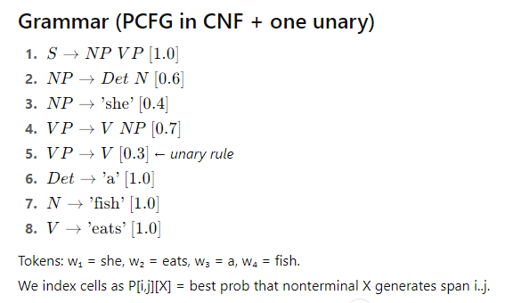
Example
“she eats a fish”

Slide 74
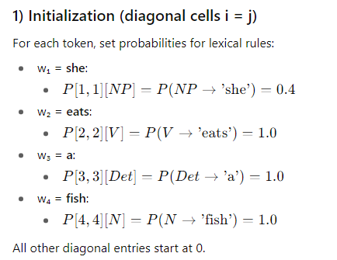

Slide 75
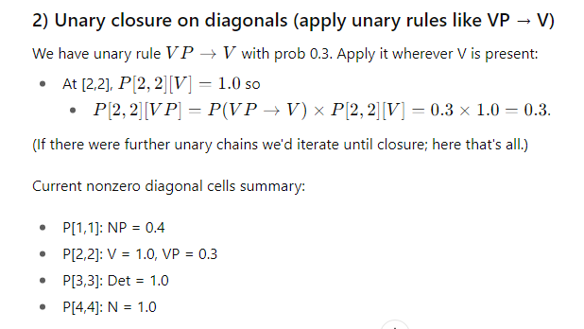

Slide 76
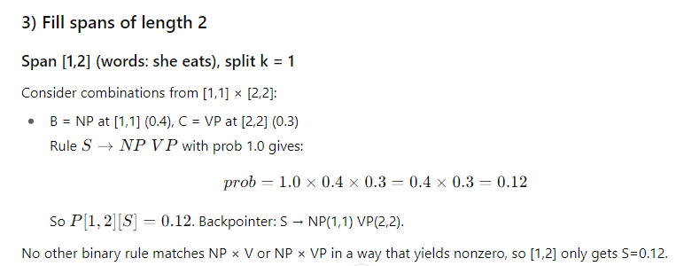

Slide 77
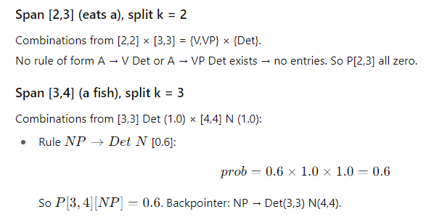

Slide 78
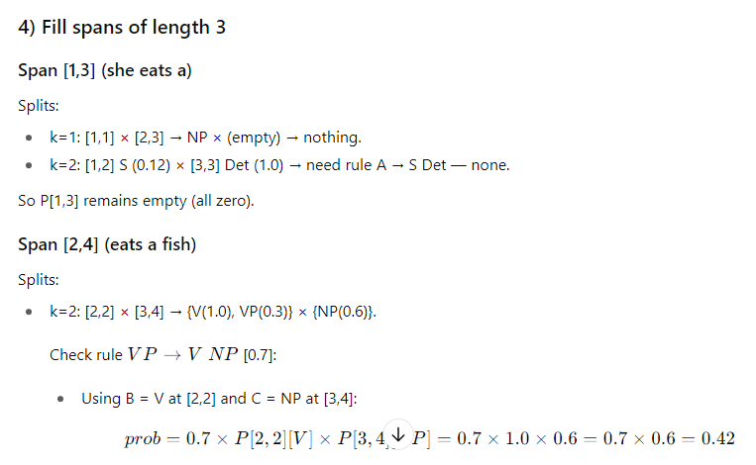
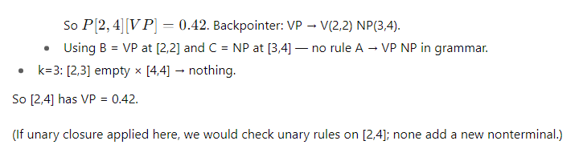

Slide 79
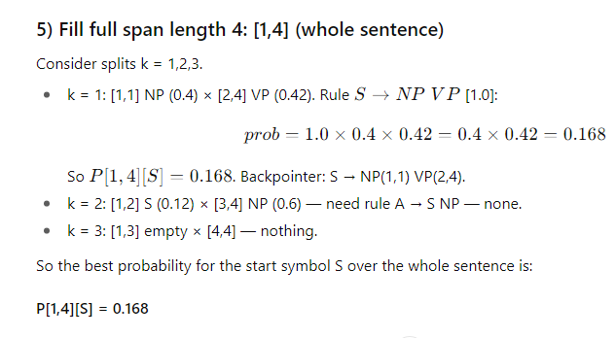

Slide 80
Probabilistic Lexicalized Context-Free Grammars (PLCFGs)

Slide 81
Motivation
Plain CFGs do not handle lexical dependencies.
PCFGs capture structure but ignore word-level relationships.
Need: A model that integrates syntax and words → Lexicalized CFGs.

Slide 82
Recap: CFG and PCFG
CFG = (N, Σ, R, S): Non-terminals, terminals, rules, start symbol.
PCFG: Adds probabilities to rules.
Limitation: Cannot distinguish 'eat pizza' vs. 'eat ideas'.

Slide 83
Lexicalization Idea
Each non-terminal is annotated with its head word.
Example: NP(dog), VP(ate), PP(with).
Head word determines syntactic role of phrase.

Slide 84
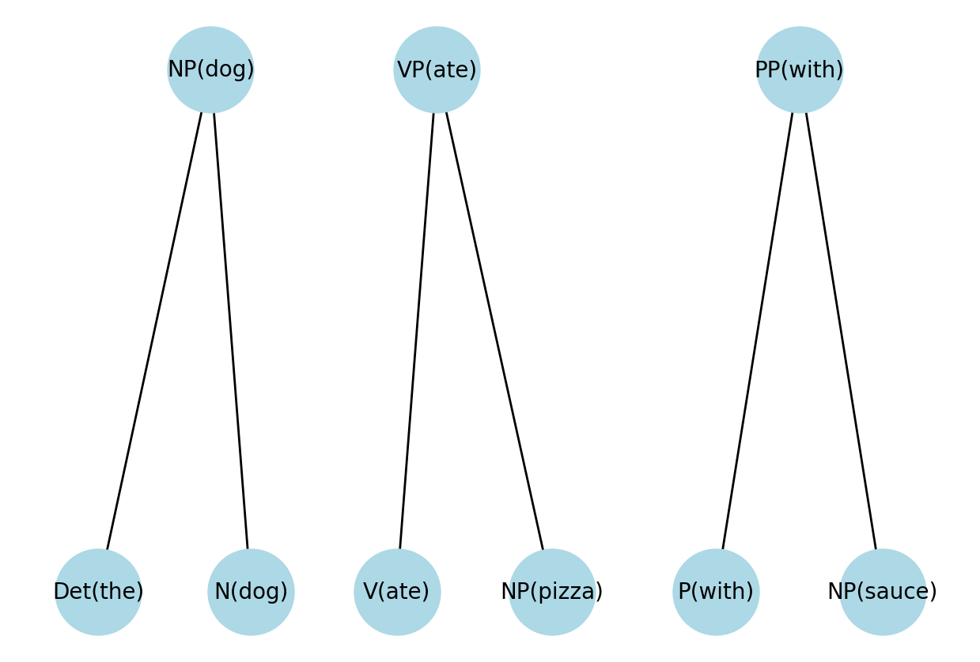
Head Rules Example
Head percolation rules: which child supplies the head word.
Examples:
NP → Det N → Head = Noun
VP → Verb NP → Head = Verb
PP → P NP → Head = P

Slide 85
Probabilistic Lexicalized CFG
Extension of PCFG: non-terminals paired with head words.
Rules conditioned on parent + head word.
Example: VP(ate) → V(ate) NP(pizza).

Slide 86
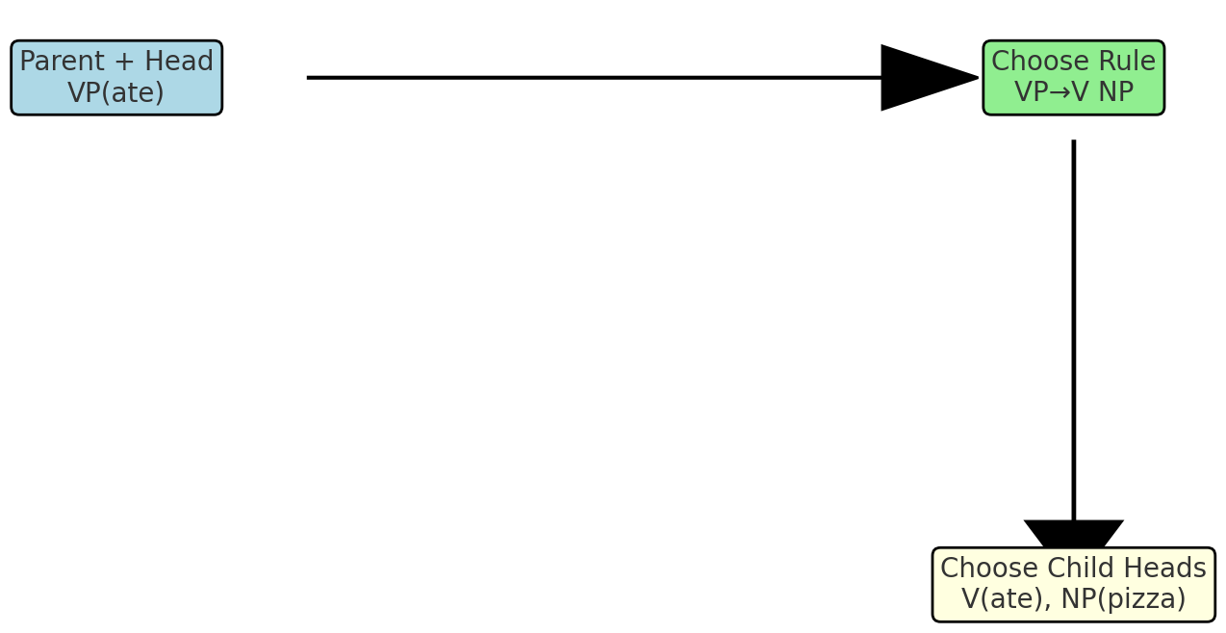
Probabilistic Model
Two-stage generation:
1. Choose rule structure given parent + head.
2. Choose head words for children.
Overall probability = product of both.

Slide 87
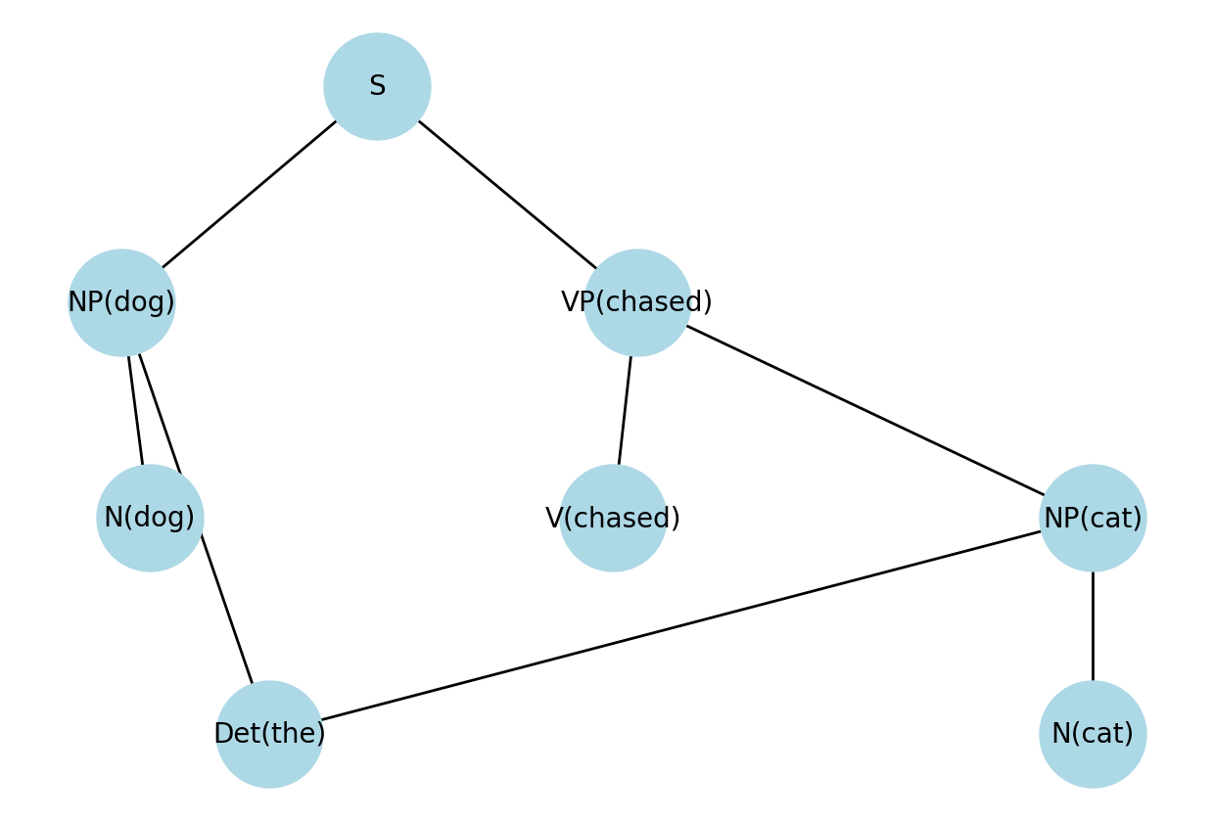
Worked Example
Sentence: 'The dog chased the cat'.
VP(chased) → V(chased) NP(cat).
NP(dog) → Det(the) N(dog).
NP(cat) → Det(the) N(cat).
Probability computed step-by-step.

Slide 88
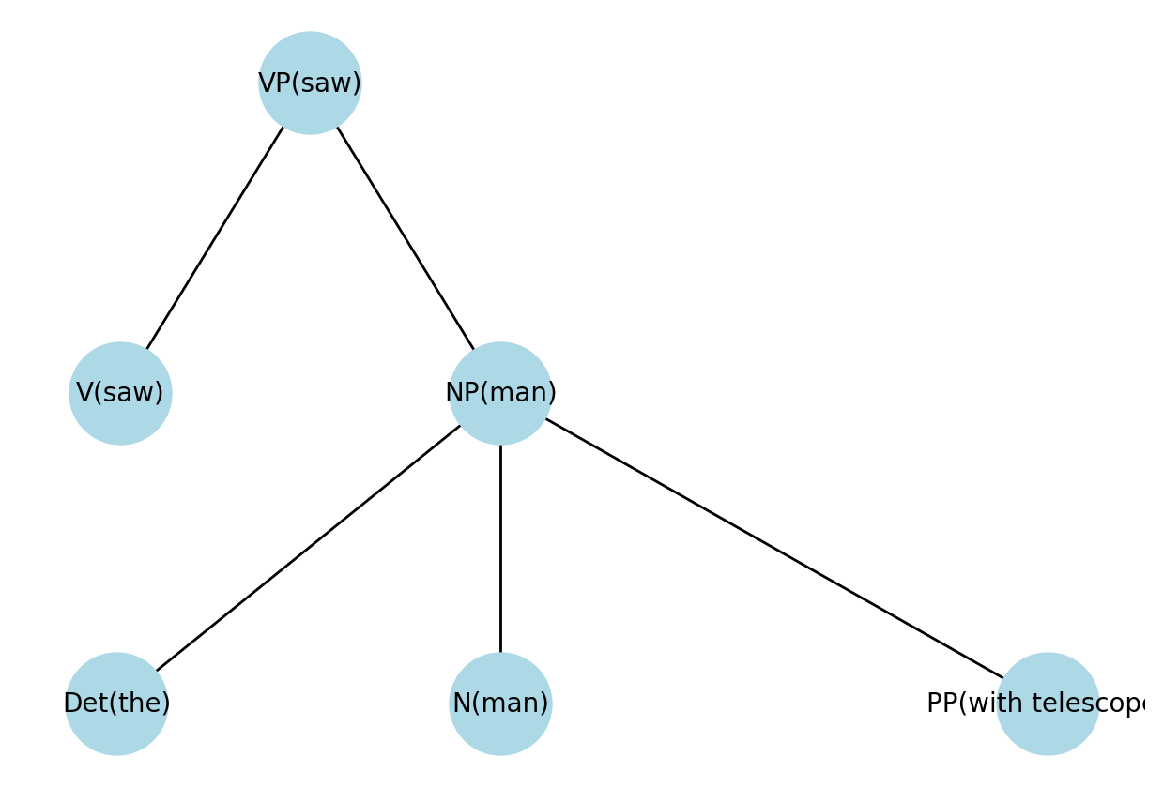
Advantages
Captures lexical dependencies (verb-object, noun-preposition).
Improves disambiguation in parsing.
Handles attachment ambiguities (e.g., 'saw the man with a telescope').

Slide 89
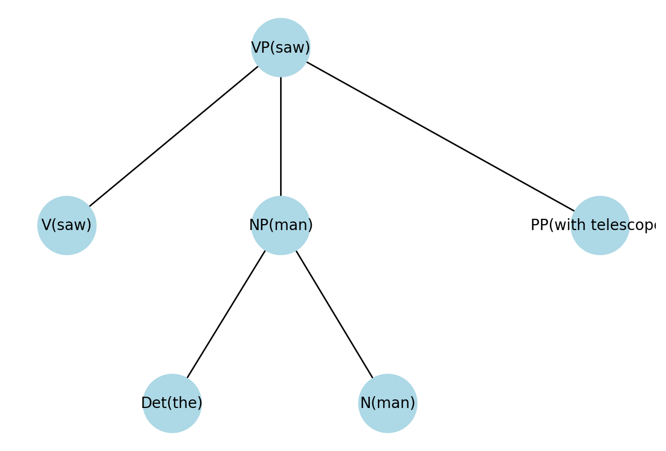
Challenges
Data sparsity: many head-dependent pairs.
Large grammar size: explosion of rules.
Estimation requires large treebanks (e.g., Penn Treebank).
Parsing complexity increases.

Slide 90
Feature Structures
What Are Feature Structures?
Feature structures are formal representations used to describe linguistic elements (like words or phrases) using attribute-value pairs. Think of them as annotated boxes that hold grammatical information.
Used to encode:
Category (CAT)
Number (NUM)
Gender, Case, Tense, etc.
Example:
[CAT: NP, NUM: PLURAL, CASE: NOM]
[ CATEGORY: noun NUMBER: singular GENDER: masculine ]
- This structure tells us the word is a singular masculine noun.

Slide 91
Why Use Them?
They allow fine-grained control over grammar rules.
Help avoid overgeneration (e.g., preventing "this flights" or "disappeared a flight").
Enable constraint-based parsing: only valid combinations of features are allowed.

Slide 92
Types of Feature Structures
Type | Description
Flat | Simple attribute-value pairs
Nested | Attributes can contain other feature structures
Typed | Each structure has a type (e.g., noun, verb) with constraints on attributes

Slide 93
Unification of Feature Structures
What is Unification?
An operation that merges two compatible feature structures.
It fails if the same attribute has conflicting values.
Example
A: [CATEGORY: noun, NUMBER: singular]
B: [CATEGORY: noun, GENDER: feminine]
Unified: [CATEGORY: noun, NUMBER: singular, GENDER: feminine]
*Failure cases:
A: [NUMBER: singular]
B: [NUMBER: plural]
Unification fails due to conflicting values.

Slide 94
Advanced Features
Disjunction: [PERS: 1 ∨ 2] → matches either person
Negation: [PERS: ¬3] → excludes third person
List-valued features: [SUBCAT: <NP, PP to>] → ordered arguments
Set-valued features: [SUBCAT: {NPnom, NPacc, NPdat}] → unordered arguments (e.g., in German)

Slide 95
Unification-Based Grammars
Use unification as part of parsing process:
HPSG (Head-Driven Phrase Structure Grammar)
LFG (Lexical Functional Grammar)

Slide 96
Advantages
Precise handling of grammatical agreement
Encodes syntax and semantics in one framework
Scalable to large grammars with rich linguistic info

